Slide 1
Motivations, Challenges, and Future Potential of Responsible Fair Clustering Work
Brian Brubach
Wellesley College

Slide 2
What we’ve seen so far…
Several classic clustering problems
A current taxonomy of fairness definitions in clustering
Algorithmic approaches to solving fair clustering problems

Slide 3
Where we’re heading…
Outcomes → Summarize risks and responsibilities that motivate careful and thoughtful approaches to fair clustering
Methods → Examine the challenges and pitfalls we can encounter doing meaningful and impactful fairness work
Next steps → Explore the vast frontier of future work that arises from interdisciplinary engagement and specific applications
Goal → Inspire and prepare you to dive into the next iteration of fair clustering work

Slide 4
Running example topics we’ll use
Criminal justice applications and algorithmic risk assessment
Clear interaction with vulnerable and marginalized populations
Popular public datasets used in fairness research (e.g., COMPAS)
Overlooked work in other disciplines (criminology, psychology, sociology, etc.)
Educational and political districting
Applications with clustering as a hard decision point
Less commonly associated with clustering
Engaging problems with unique needs
Supervised learning
Longer history of algorithmic fairness than clustering
Inspired a lot of fair clustering ideas

Slide 5
Where we’re heading…
Outcomes → Summarize risks and responsibilities that motivate careful and thoughtful approaches to fair clustering
Methods → Examine the challenges and pitfalls we can encounter doing meaningful and impactful fairness work
Next steps → Explore the vast frontier of future work that arises from interdisciplinary engagement and specific applications

Slide 6
Ethical questions for working on sensitive subjects
By design, algorithmic fairness interacts with vulnerable and marginalized communities
How can we ensure that we serve and give back to these communities?
Avoid exploiting for research topics and publications
How can we avoid harming these communities?
AAAI code of ethics:
https://www.aaai.org/Conferences/code-of-ethics-and-conduct.php
“1.1 Contribute to society and to human well-being, acknowledging that all people are stakeholders in computing.”
“1.2 Avoid harm.”

Slide 7
Harmful fairness example: “ban the box”
Problem → Employers discriminate against applicants’ criminal history
Racial disparities in criminal justice propagated into employment
Fair solution → Ban employers from asking about criminal history
New problem → Evidence that employers start using race as a proxy for the unknown variable (criminal history), increasing racial discrimination
Agan and Starr (2018) “Ban the Box, Criminal Records, and Statistical Discrimination: A Field Experiment”
Kleinberg and Mullainathan (EC 2019) “Simplicity creates inequity: implications for fairness, stereotypes, and interpretability”

Slide 8
More harmful fairness examples
Incorporating temporal analysis shows that demographic parity and equal opportunity in fair
Liu, Dean, Rolf, Simchowitz, and Hardt (ICML 2018) “Delayed Impact of Fair Machine Learning”
“Imposing a fairness constraint can make the disadvantaged group worse off if the fairness constraint and the utilities of the population mismatch.”
Ben-Porat, Sandomirskiy, and Tennenholtz (AAAI 2021) “Protecting the Protected Group: Circumventing Harmful Fairness”

Slide 9
Contrast with work that had a clear positive impact
Identified discrimination in a healthcare algorithm due to biased proxy variable
Obermeyer, Powers, Vogeli, and Sendhil Mullainathan (Science 2019) “Dissecting racial bias in an algorithm used to manage the health of populations”
Authors worked with manufacturer improve variable choice and reduce bias

Slide 10
Where we’re heading…
Outcomes → Summarize risks and responsibilities that motivate careful and thoughtful approaches to fair clustering
Methods → Examine the challenges and pitfalls we can encounter doing meaningful and impactful fairness work
Next steps → Explore the vast frontier of future work that arises from interdisciplinary engagement and specific applications

Slide 11
Considerations for modeling and problem formulation
Specificity → Applications and context matter
Beneficial to define and model fairness for a specific social problem
Application details can suggest fascinating new challenges to solve
General purpose abstractions can be useful, but are often over-sold
Use caution mapping ideas from fair classification to fair clustering

Slide 12
Considerations for modeling and problem formulation
Non-modularity → Fairness interventions do not act in a vacuum
Broader context and upstream/downstream effects are important
Can’t simply swap an “unfair” algorithm for a “fair” one
Different bad inputs require different fair algorithms
How the algorithm’s output is used must also be considered
Example considering downstream effects
Kannan, Roth, and Ziani (FAccT 2019) “Downstream effects of affirmative action”

Slide 13
Considerations for modeling and problem formulation
Interdisciplinarity → Read and collaborate outside CS
Important to know your limits as a researcher (and reviewer)
Respect prior work in other fields and avoid reinventing the wheel
Understand what compromises are most acceptable when ideal can’t be achieved
Establish what is and isn’t allowed in practice

Slide 14
Considerations for modeling and problem formulation
Stakeholders → Real people are involved
Who is this for?
Who are we being fair to?
What do they want?
How do they want fairness defined?

Slide 15
School districting: the problem
The U.S. public education system is divided into districts
“Clusters” of households whose children attend the same school system
Funding, etc. is not distributed equitably
Districts are segregated by demographics such as race, income level, etc.
Contributes to inequity via factors such as local property taxes funding schools

Slide 16
School districting: the fair clustering solution
Hammer → Fair clustering
Nail → Unfair school districts
Solution → Redraw school districts using fair clustering techniques
E.g., draw “group fair” districts with demographic parity for race or income
Maybe also bound geographic and population size of each cluster
What are the limitations and concerns of this approach?
Are we serving all wants/needs of stakeholders?
Maybe some communities don’t want to be split or combined

Slide 17
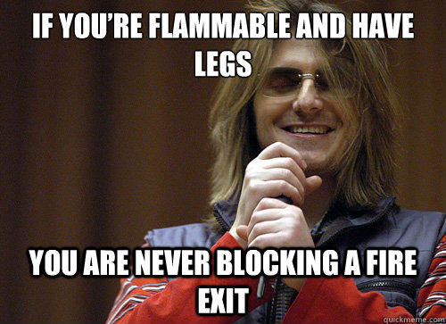
School districting: the problem with the fair clustering solution
Need to factor in costs and logistics
Some works do this
People move for schools
Families will leave a district if schools are perceived to be “bad” (or they don’t like the demographics of the student body)
Families will move to be near “good” schools
Solution may not be desired by stakeholders
Solution doesn’t engage with broader context of the problem or downstream effects
Solution doesn’t engage with legal history
Echoes historical solution of bussing

Slide 18
School districting: very brief legal history of bussing
Brown v. Board of Education (1954)
Made de jure school segregation illegal in the U.S.
De facto segregation exists to this day
Bussing
Reassign students to better balance racial demographics
Similar to group fair clustering
Milliken v. Bradley (1974)
Asked whether students could be bussed across district lines between urban Detroit and its suburbs
Ruling prevented states from bussing across district lines
Allowed families to avoid integration by moving districts
May have contributed to “white flight” and increased housing segregation

Slide 19
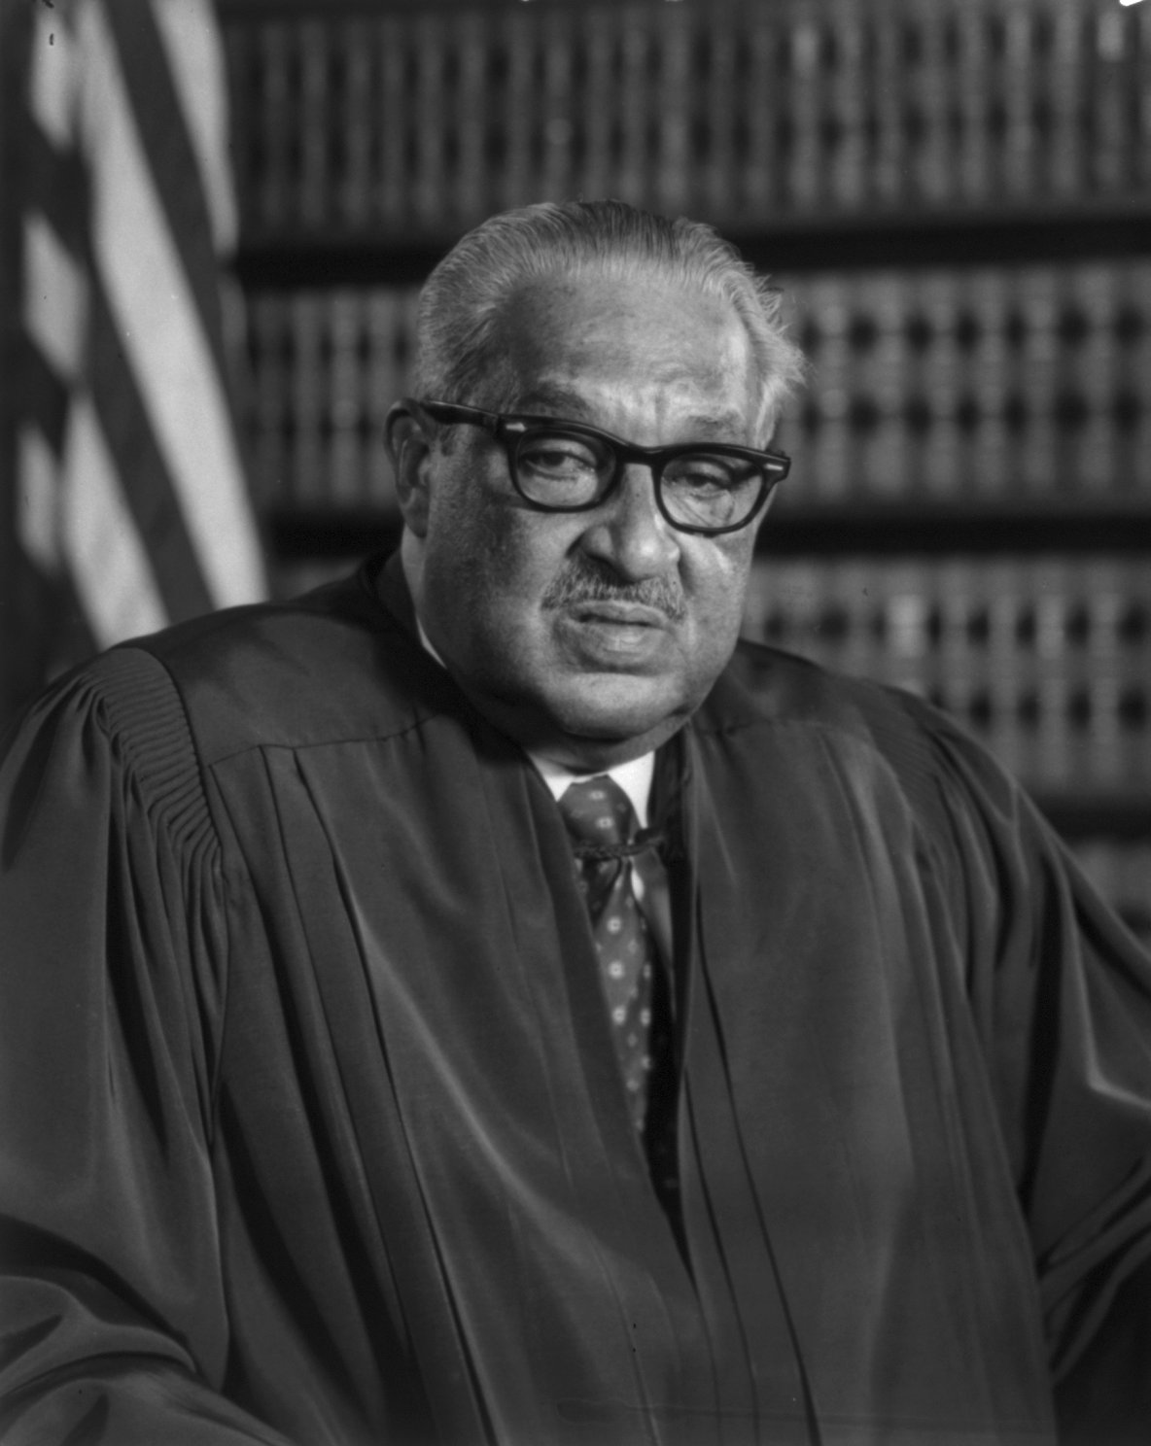

School districting: Thurgood Marshall’s dissent in Milliken
“Moreover, the result of a Detroit-only decree to this Court would be to increase the flight of whites from the city to the outlying suburbs, compounding the effects of the present rate of increase in the proportion Negro students in the Detroit system. Thus, even if a plan were adopted which at its outset provided in every school a 65 Negro, 35 white racial balance mix in keeping with the Negro-white population of the total school population, such a system would in short order devolve into an all-Negro system. For these reasons, the Detroit-only plan simply has no hope of achieving actual desegregation.”
From Thurgood Marshall’s dissent in Milliken v. Bradley (1974)
Recording from: https://www.oyez.org/cases/1973/73-434

Slide 20
School districting: potential future directions
Ask experts in education policy how fair clustering might help them
Learn about and factor in the needs of all stakeholders from parents to school administrators
Incorporate game theoretic aspects into the model
Draw “fairest” possible hypothetical districts for the purpose of comparing to and evaluating current districts
Can provide data/analysis to argue for systemic changes
Can reveal evidence of discrimination
Explore how clustering can interface with potential systemic changes
E.g., housing regulations
Consider a related problem like school assignment within a district

Slide 21
Evaluation, experiments, and datasets
Lots of room for improvement in empirical evaluation
Methods-based work positions datasets as decontextualized benchmarks
Can lead to unconvincing empirical evaluation
Let’s look at some common dataset issues related to
Poor quality of popular public datasets
Common misunderstanding/mistakes
Mismatched fairness definitions
Lack of real world meaning in experiments
Benchmarks and community norms

Slide 22
Dataset issue 1: noisy demographic labels
Important to know where sensitive features in dataset come from
Criminal justice datasets often have noisy race labels
Popular “German Credit” dataset has coding errors in sex label
Grömping (2019) “South German Credit Data: Correcting a Widely Used Data Set”
Limits the ability to evaluate demographic fairness with these datasets

Slide 23
Dataset issue 2: weird features & the Adult dataset
Adult dataset → Publicly available census income dataset
Intended for predicting whether income exceeds $50K/year
Commonly used as a fairness benchmark
Fair clustering works → Typically use only numerical features
age, fnlwgt, education-num, capital-gain, and hours-per-week
Most seem like reasonable features, but what is fnlwgt?
fnlwgt feature → Lots of issues
Orders of magnitude larger than other features and must be normalized to avoid dominating other features
Not clear that it is appropriate to use as a feature regardless
Meant to be a weight associated with an entry, not a feature
Should probably be used when sampling small subset

Slide 24
Dataset issue 2: weird features & the Adult dataset
“The UCI Adult feature “fnlwgt”. This column is actually not a demographic feature of an individual but a weight value computed by the Census Bureau to make the sample representative for the US population. We compared the “fnlwgt” data to all weight variables available in IPUMS CPS but did not find an exact match. The closest match is the variable “UH_WGTS_A1”, which has a similar distribution. Since we did not identify an exact match for “fnlwgt” and the variable is not a property of an individual, we do not utilize it further in our experiments.”
Ding, Hardt, Miller, and Schmidt (NeurIPS 2021) “Retiring adult: New datasets for fair machine learning”

Slide 25
Dataset issue 3: meaning & equality of opportunity
Equality of opportunity → Fairness definition from supervised learning
People whose true label is “positive” should have an equal chance of being classified as positive regardless of group membership
I.e., avoid discrimination in false negatives, but don’t worry about inequality in false positives
E.g., qualified job candidates get equal chance at interviewing
Hardt, Price, and Srebro (NeurIPS 2016) “Equality of opportunity in supervised learning”
Wording of definition assumes “positive” label is a good outcome
Challenge → “Positive” label is a bad outcome in many datasets
Leads to backwards experiments if not corrected
E.g., don’t give people “equal opportunity” to be labeled high risk and denied bail

Slide 26
Dataset issue 4: fairness mismatch & Diabetes dataset
Diabetes dataset → Publicly available diabetes patient dataset
Commonly used as a fairness benchmark
Used to evaluate group fairness in clustering with sex as the sensitive
Problem→ Health conditions affect men and women differently
Balancing male/female membership in clusters could be inappropriate and harmful at worst
Important to consult an expert before using health/medical data to ensure the fairness intervention makes sense

Slide 27
Dataset issue 5: benchmarks break all the rules
Many previous issues and similar mistakes are enshrined as benchmarks
Reviewers expect to see these experiments replicated in new work
Ideal to supplement classic benchmarks with better experiments
Benefit of pursuing a specific application with relevant data

Slide 28
Concluding thoughts on datasets and evaluation
Recuring questions to consider:
How was data prepared? Who reported sensitive features?
What does it “mean” to cluster this data this way?
What do domain experts think of this experiment?
More reading on datasets:
Fabris, Messina, Silvello, and Susto (arxiv 2022) “Algorithmic Fairness Datasets: the Story so Far”
Bao, Zhou, Zottola, Brubach, Desmarais, Horowitz, Lum, Venkatasubramanian (NeurIPS 2021) “It's COMPASlicated: The Messy Relationship between RAI Datasets and Algorithmic Fairness Benchmarks”
Gebru, Morgenstern, Vecchione, Wortman Vaughan, Wallach, Daumé Iii, and Crawford (Comm. ACM 2021) “Datasheets for datasets”

Slide 29
Where we’re heading…
Outcomes → Summarize risks and responsibilities that motivate careful and thoughtful approaches to fair clustering
Methods → Examine the challenges and pitfalls we can encounter doing meaningful and impactful fairness work
Next steps → Explore the vast frontier of future work that arises from interdisciplinary engagement and specific applications

Slide 30

Wide open frontier of future work in fair clustering
Adding fairness constraints to
a classical optimization problem
Interdisciplinary work with messy real-world problems and broader context

Slide 31
Recommendations for future work
Find a specific social problem/application/domain that interests you and learn about it from sources outside CS academia
Study every facet of a problem and find a new perspective to explore
Seek interdisciplinary collaborations and expert input
Consider broader context and upstream/downstream impact
Build models and fairness definitions grounded in evidence and need
Start with a problem or dataset in mind
Nail first as opposed to hammer first

Slide 32
Political districting: the problem
U.S. states are divided into single-member, winner-take-all districts
Each district elects a representative to congress
Voters/parties/groups are disenfranchised through gerrymandering
Open problem for over 200 years

Slide 33
Political districting: what is fair?
Balanced population
Preserving communities (e.g., towns) in same district
Compact districts or k-median objective
Competitive districts
Majority minority districts
Proportional representation

Slide 34
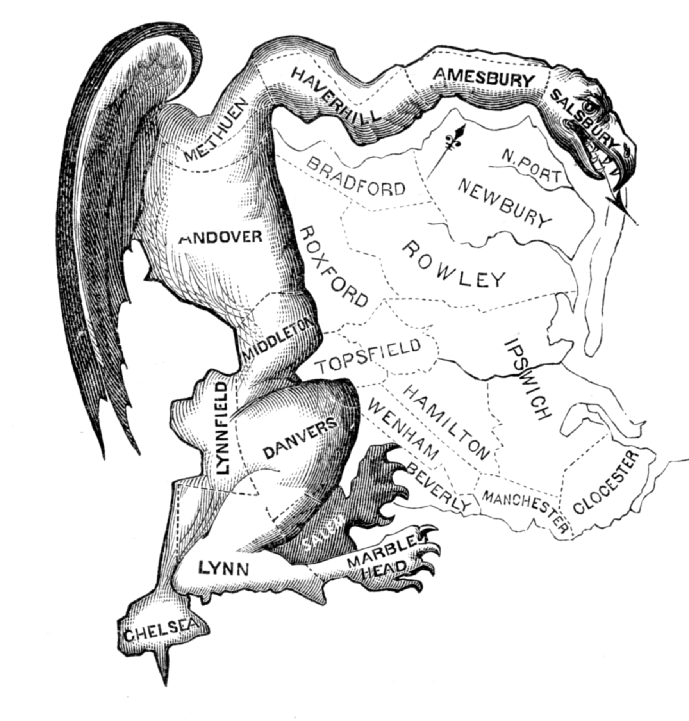
Political districting: what is unfair?
Wasted votes/large “efficiency gap”
Weird looking districts
One party/group getting disproportionate share of representation
One party/group disenfranchised
“Safe” districts for incumbents
“Kidnapping” incumbents
Redistricting maps that are outliers with respect to a random sample of legal maps

Slide 35
Political districting: considering different perspectives
Algorithmic fairness → Inspire new fairness definitions and civil rights
Brubach, Chakrabarti, Dickerson, Khuller, Srinivasan, and Tsepenekas. (ICML 2020) “A pairwise fair and community-preserving approach to k-center clustering”
Impossibility results → Show which fairness goals are impossible
E.g., can’t guarantee that all pairs of voters who share same district in a majority of possible maps will share district
Downstream effects → Ask how voter incentives are affected
Brubach, Srinivasan, and Zhao (EC 2020) “Meddling metrics: the effects of measuring and constraining partisan gerrymandering on voter incentives”
Systemic changes → Show benefits of an alternative system
Garg, Gurnee, Rothschild, and Shmoys (arxiv 2021) “Combatting Gerrymandering with Social Choice: the Design of Multi-member Districts”

Slide 36
Thanks!
Questions? Discussion?

Slide 37
Thanks!
Questions? Discussion?

Slide 38
Thanks!
Questions? Discussion?

